Slide 1

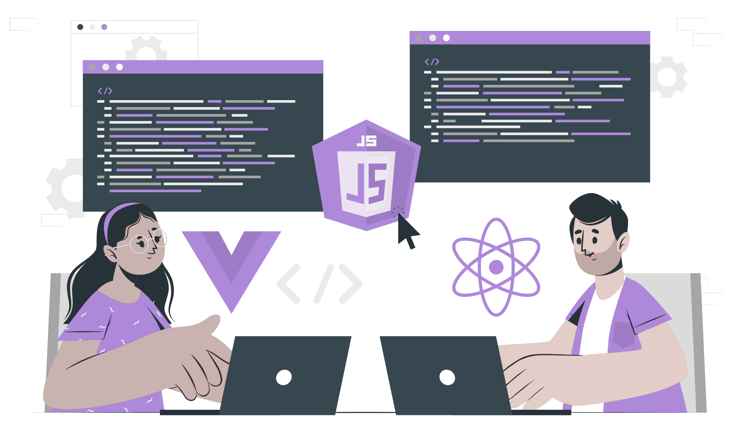
Values and Datatypes

Slide 2
Lecture CheckList
Introduction to datatypes.
Datatypes in Javascript.

Slide 3
Introduction to datatypes.
Data types are used to define the way the data is stored in memory. Storing data is an essential part of programming as it enables the manipulation, processing and sharing of information within a program.
The data type is a classification of data according to the type of value that we want to operate on.

Slide 4
JavaScript is a dynamically typed language
JavaScript is a dynamically typed language, which means the data type is defined by the engine itself during execution, the programmer need not explicitly declare the data type during defining. JavaScript engine is powerful enough to determine the type of data that we declare.

Slide 5
DataTypes in JavaScript
String
Number
Bigint
Boolean
Undefined
Null
Symbol
Object

Slide 6
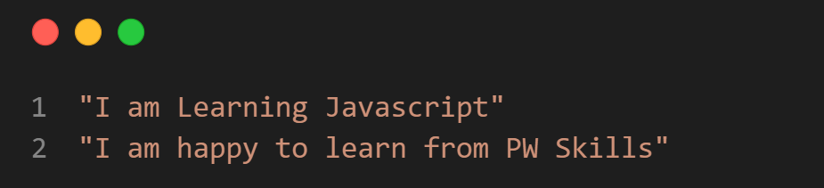
String
Strings are a data type used for representing text. A string is a sequence of characters, enclosed in single or double quotes.

Slide 7
Number
Numbers are a data type used for representing numeric values. Numbers can be an integer, whole number or decimal values [ floating point values ].

Slide 8
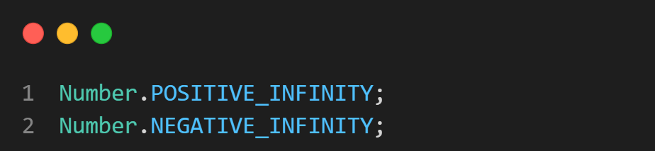
Number
Other possible number values are infinity and NaN.
Infinity is a special value that is greater than any number.

Slide 9
Number
NaN stands for "Not a Number" and is a special value that represents the result of an undefined or unrepresentable mathematical operation.

Slide 10
Bigint
Numbers greater than the maximum safe number or lesser than the minimum safe number, the BigInt data type can be used.
The BigInt data type number can also be treated as a regular number by adding n to it at the end.
Notes:
In JavaScript, there is a maximum safe number that can be represented by the Number data type, is approximately 2^53 - 1. This means that integers larger than this value may lose precision when represented as a JavaScript number.
Similarly, there is also a minimum safe number that can be represented by the Number data type, which is approximately -(2^53 - 1). This means that integers smaller than this value may lose precision when represented as a JavaScript number.

Slide 11
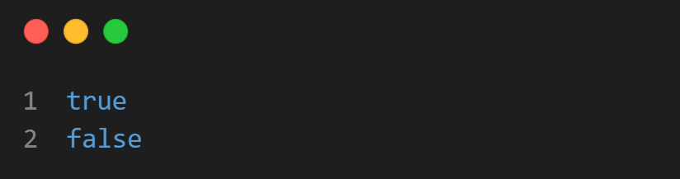
Boolean
Boolean is a logical type that is either true or false.

Slide 12
Undefined
undefined is a special value that indicates that a variable or property has been declared but has not been assigned a value.

Slide 13
Null
Null means nothing or empty value. It is often used to indicate that a variable or property has no value.

Slide 14
Symbol
A Symbol is a datatype that can be used as an object property key.
We will exploring objects in depth in further lectures. One thing to note is that Symbols are unique and are often used as object property key.

Slide 15
Object
Objects are non-primitive data because they can hold multiple primitive data types within them.
The object data type can contain:
Array
Object.
Notes:
In javascript, numbers, strings, booleans, undefined, null are called as primitive data types.

Slide 16
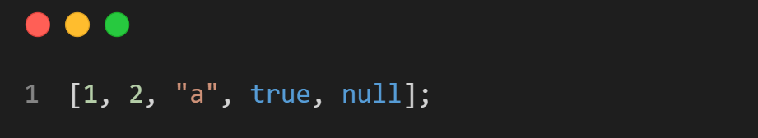
Array
Array is a special type of object that is used to store a collection of elements. Each element can be of any data type and can be accessed by an index, which is a zero-based number starting from 0.
Arrays are created by using the [ ] brackets.

Slide 17
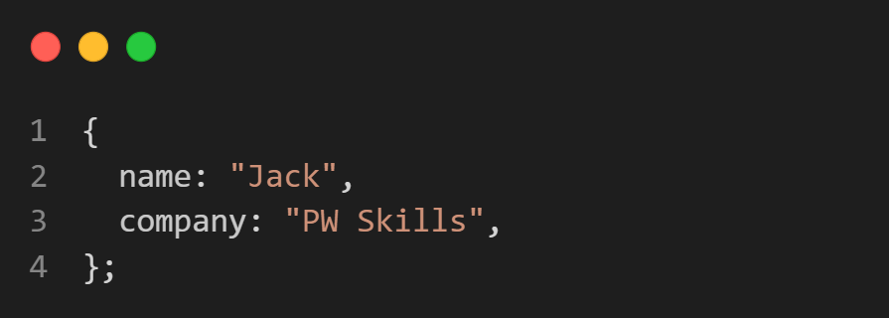
Object
Object is a collection of properties, where each property has a name and a value. Objects are usually created by curly brackets { }. Each property of an object can be accessed using the dot notation or the bracket notation.

Slide 18
THANK YOU

